Slide 1
Open Science in
CO₂ Electroreduction
Dr. Federico Dattila
Department of Applied Science and Technology
Polytechnic of Turin
CHEAC Seminar
12/12/2025, University of Copenhagen

Slide 2
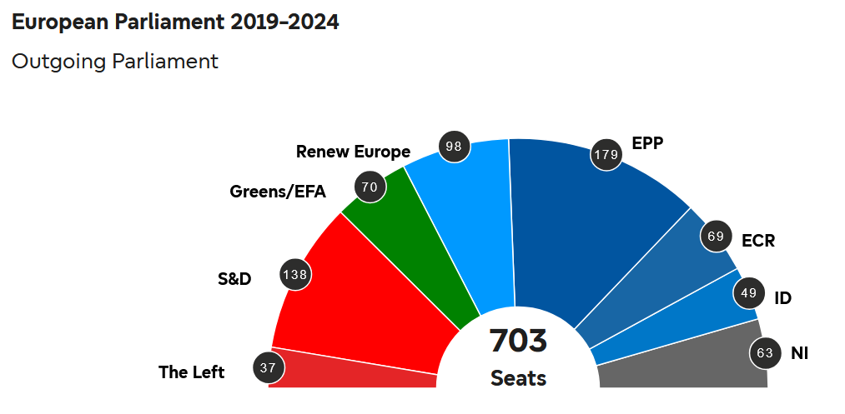
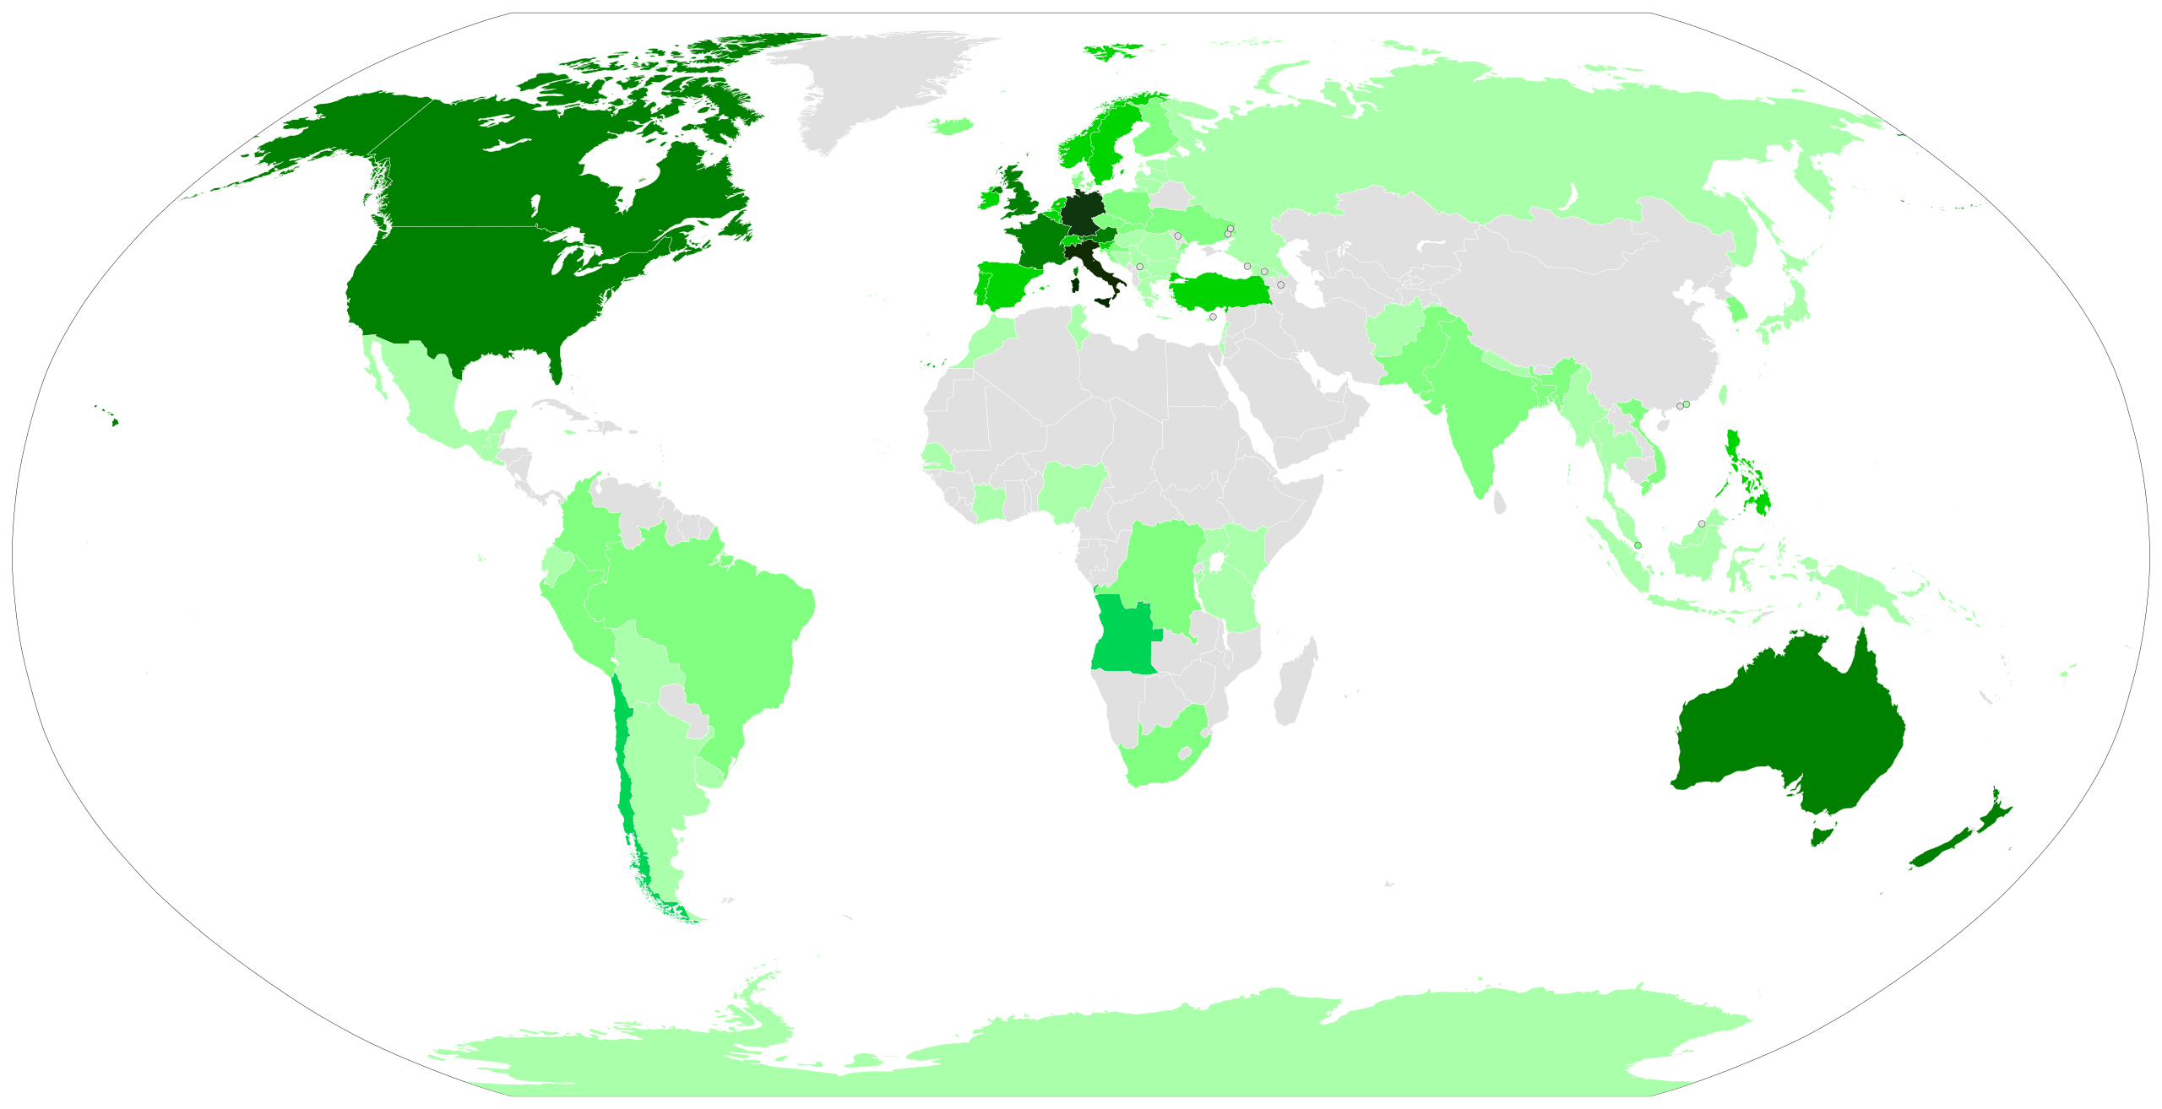
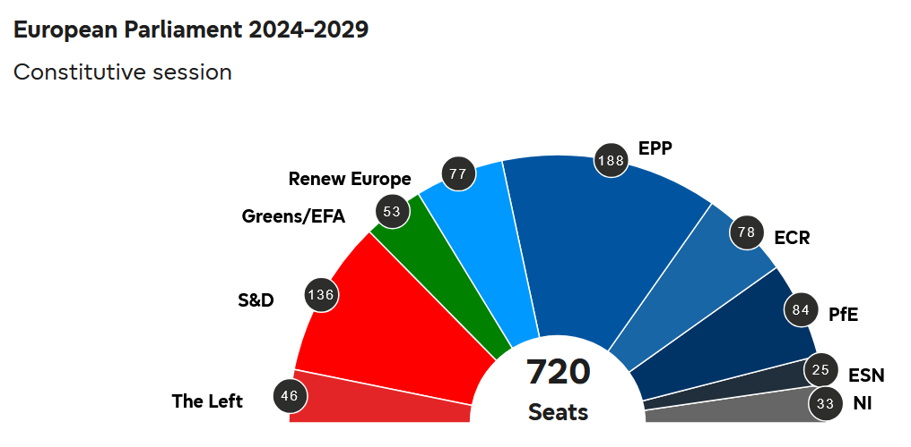
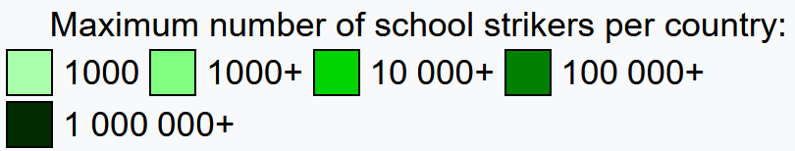
The power of people
Fridays for Future (2018-19)
European Parliament
2019
2024
FFF, https://en.wikipedia.org/wiki/Fridays_for_Future, online, accessed on 11/12/2025.
1
EP elections, https://results.elections.europa.eu/en/, online, accessed on 11/12/2025.

Slide 3
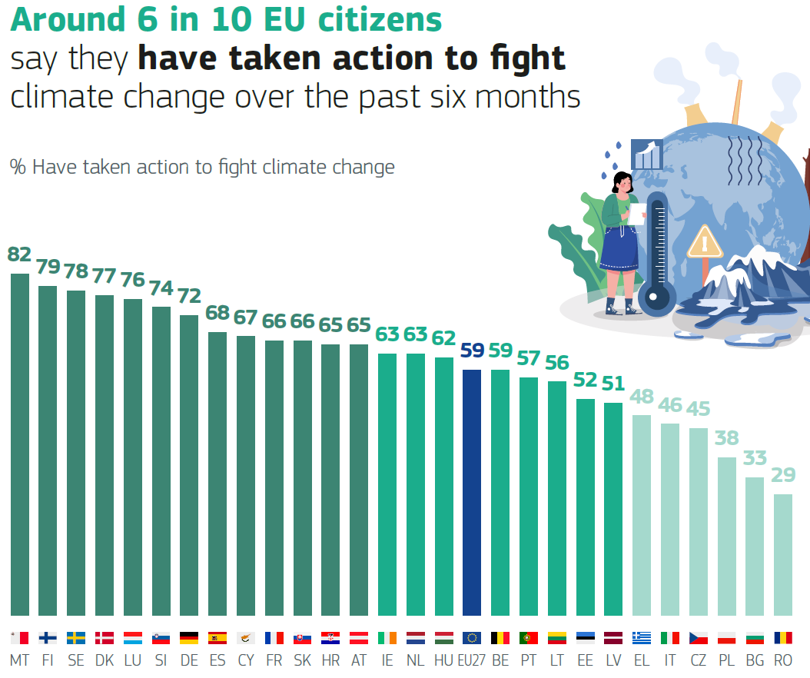
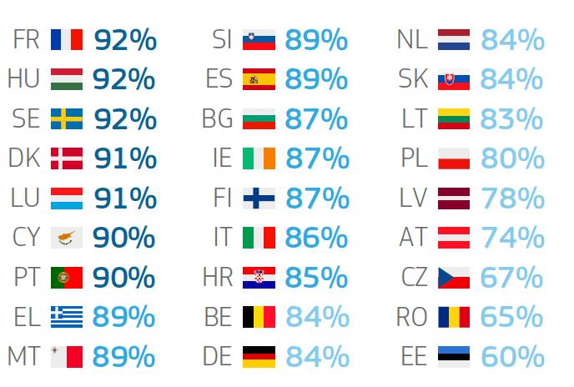
Do we need more awareness?
More than 8 in 10 EU citizens consider climate change a serious problem
Climate change, https://europa.eu/eurobarometer/surveys/detail/3472, online, accessed on 11/12/2025.
2

Slide 4

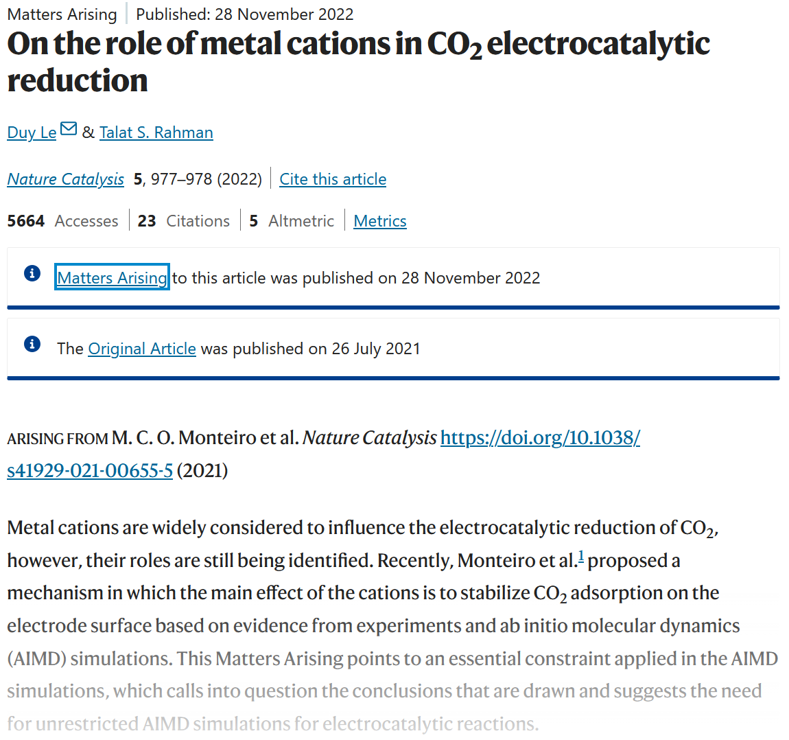
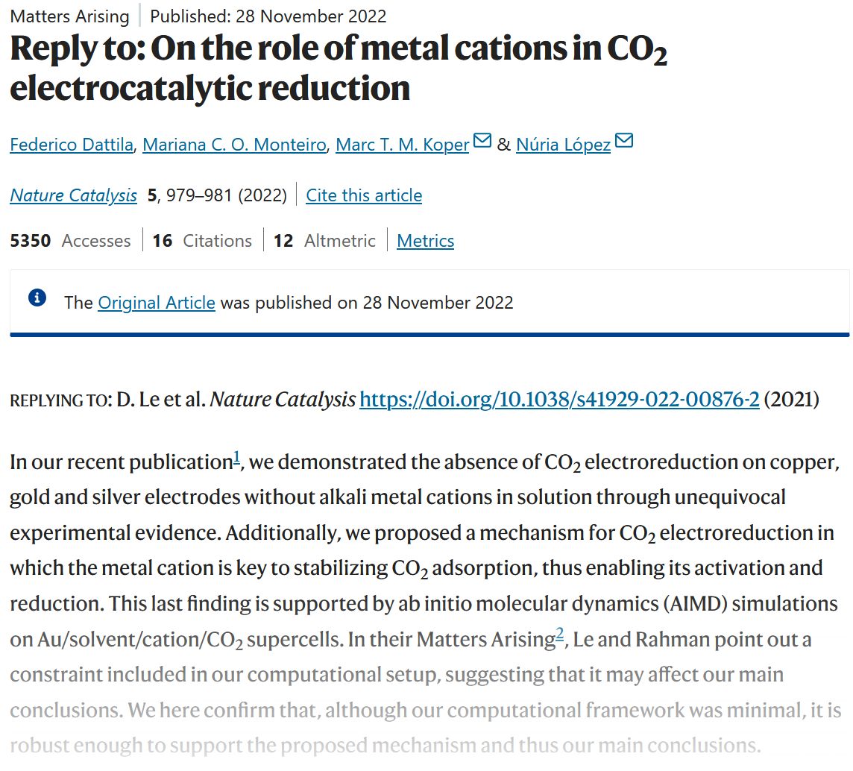
The power of open science
Nat. Catal. 2022, 5, 977–978.
Nat. Catal. 2021, 4, 654–662.
Nat. Catal. 2022, 5, 979–981.
3

Slide 5
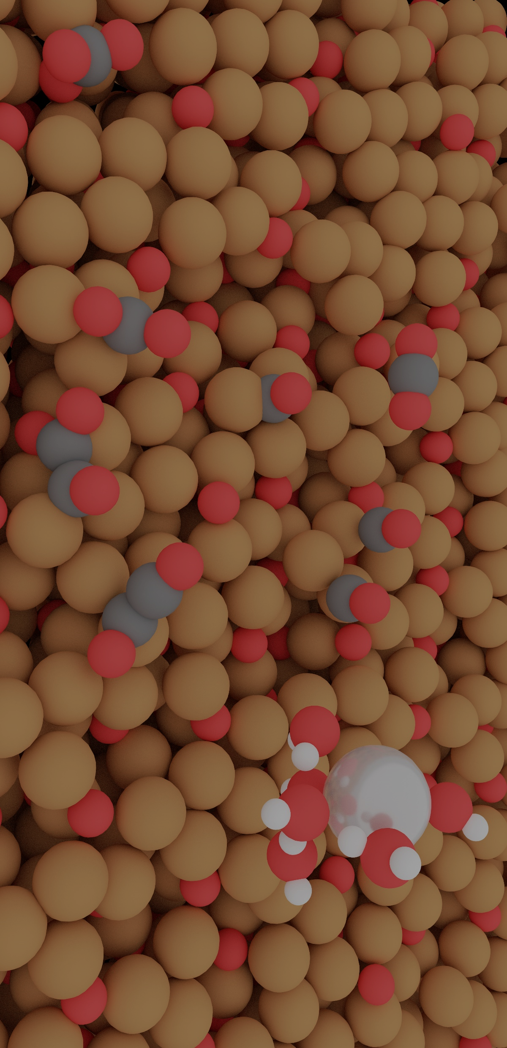
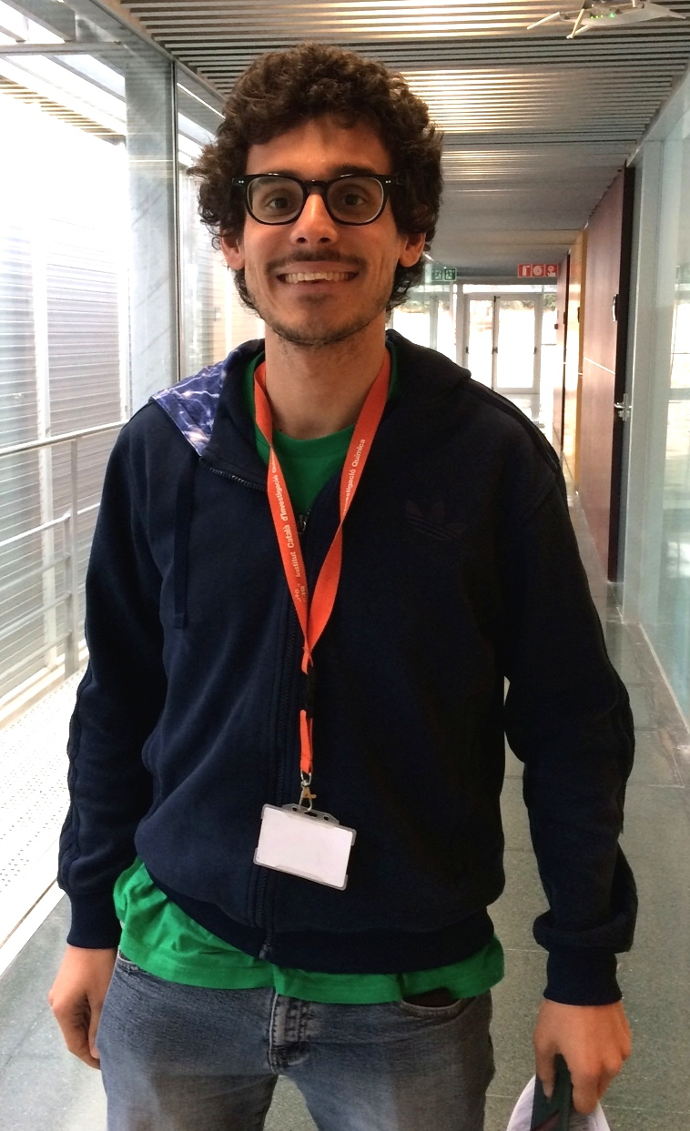
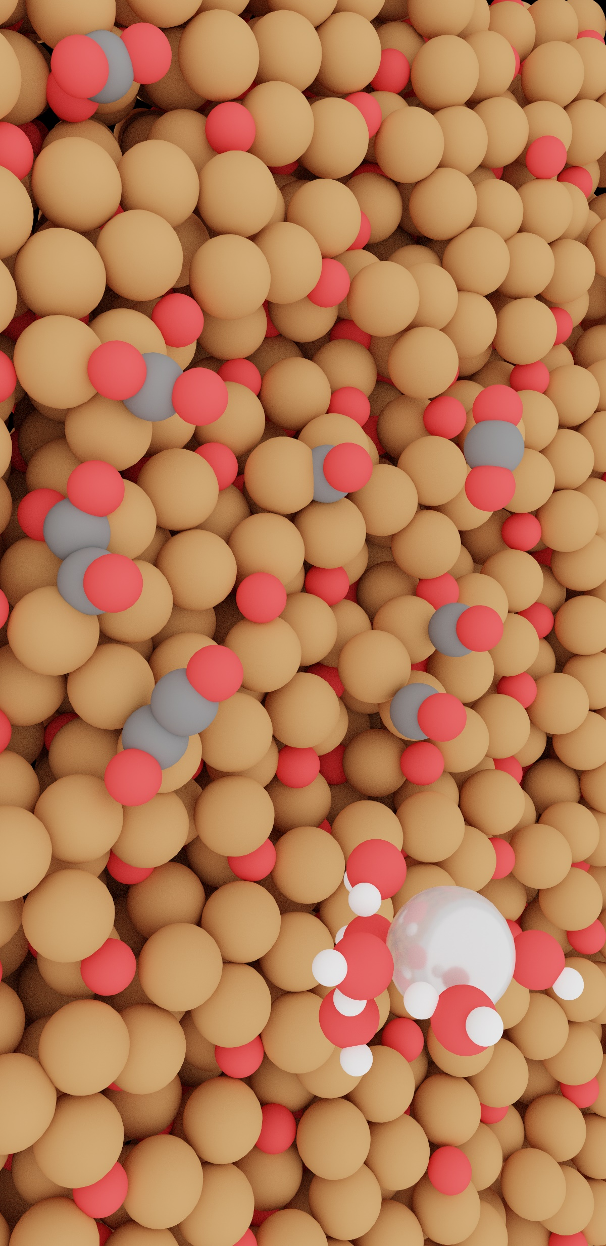
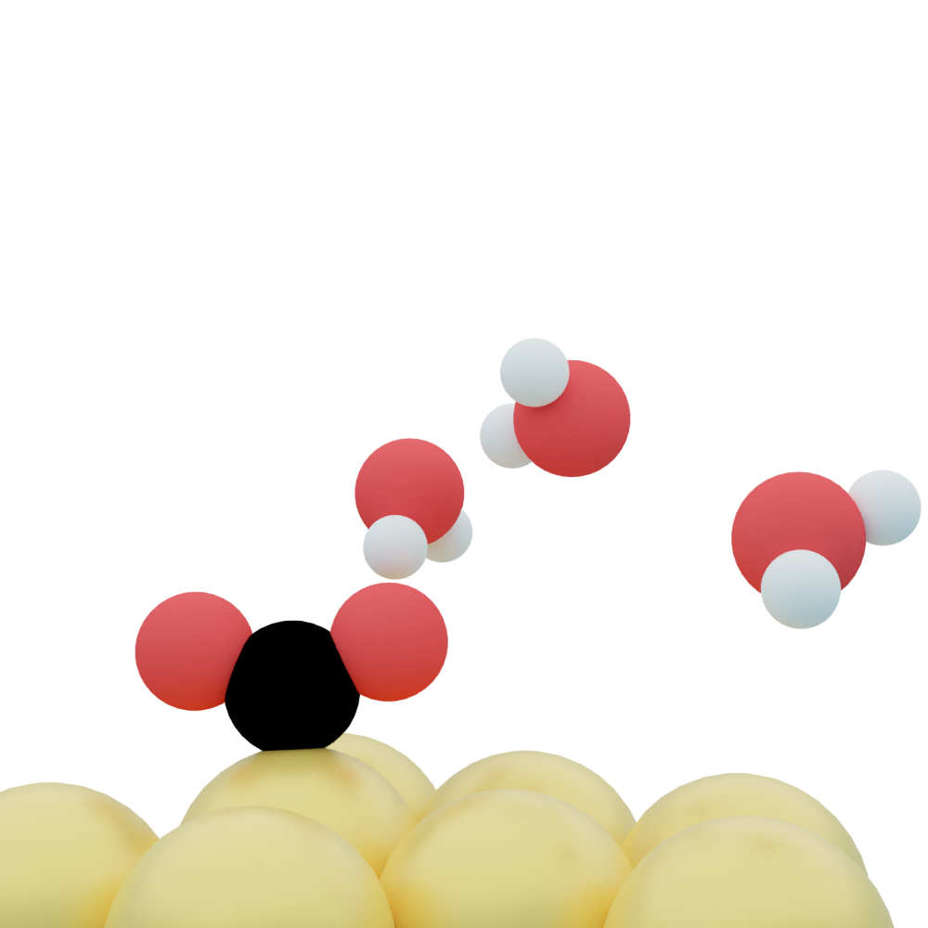
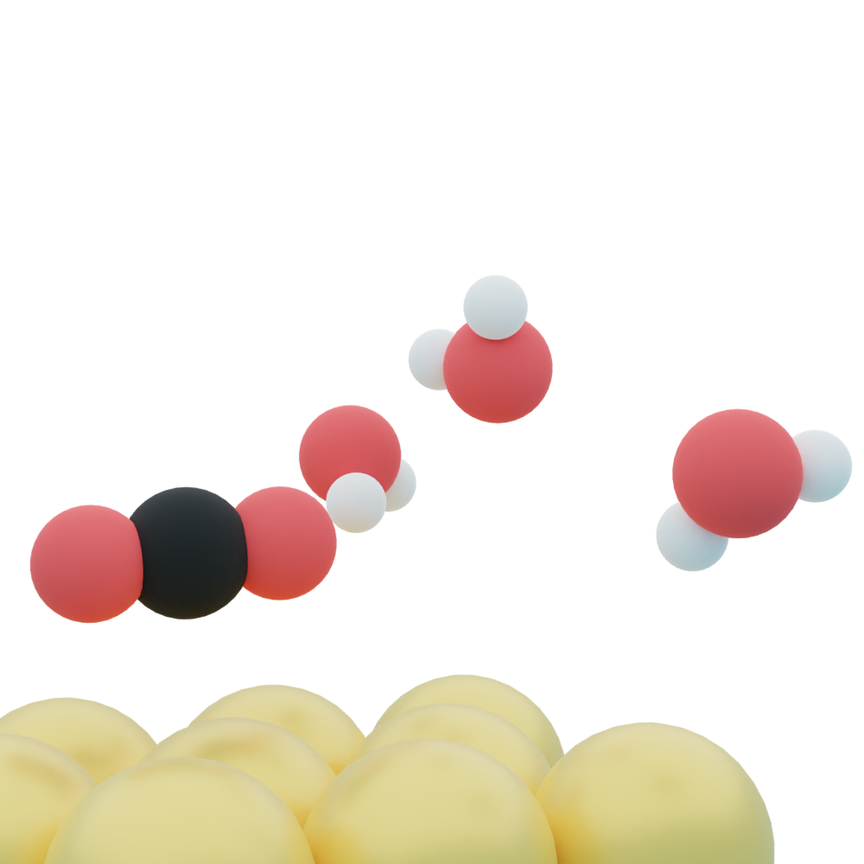
Cations, the elephants in the room!
1st year PhD student, 2018
4

Slide 6
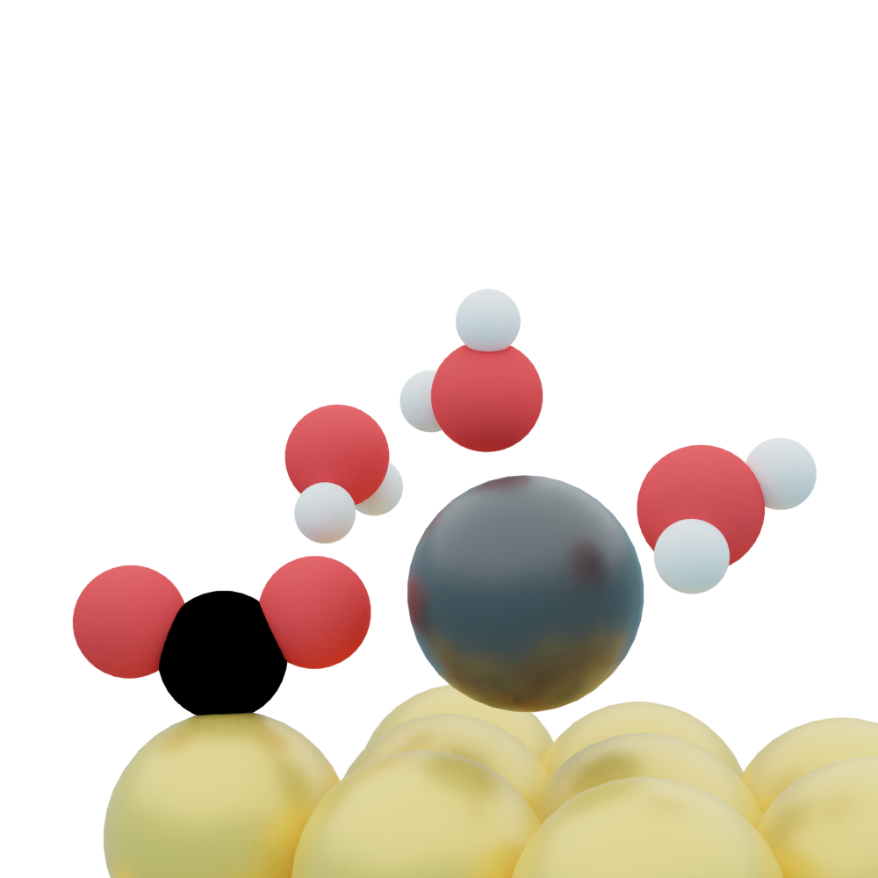
CO₂ activation
Nat. Catal. 2021, 4, 654–662.
DFT dataset: 10.19061/iochem-bd-1-194.
5

Slide 7
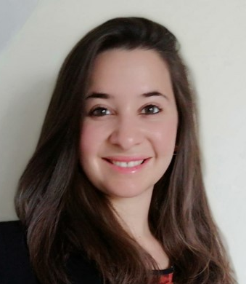
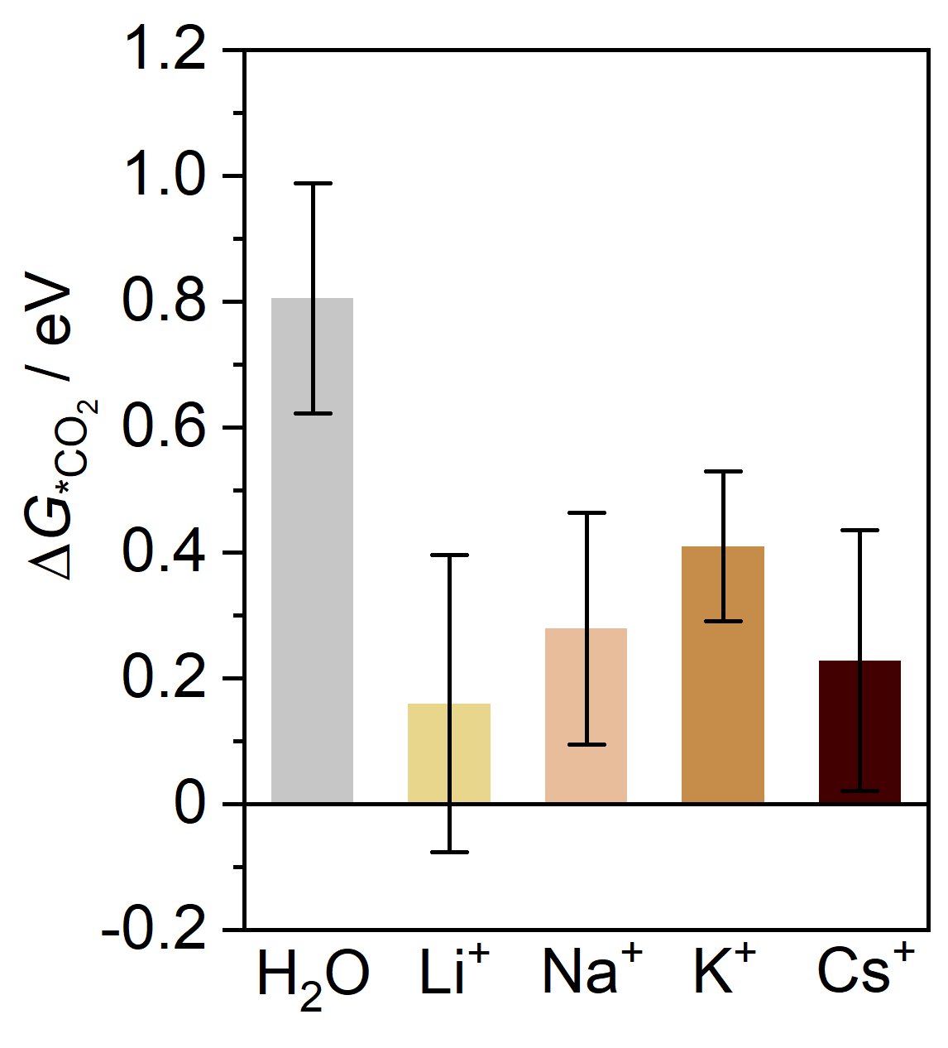
CO₂R needs cation on Ag, Au, Cu
U = 0 V vs SHE
Au(111)
U = 0 V vs SHE
Au(111)
Dr. Mariana
Monteiro
Nat. Catal. 2021, 4, 654–662.
J. Am. Chem. Soc. 2022, 144, 1589–1602.
ChemCatChem 2025, 17, e00749.
6

Slide 8
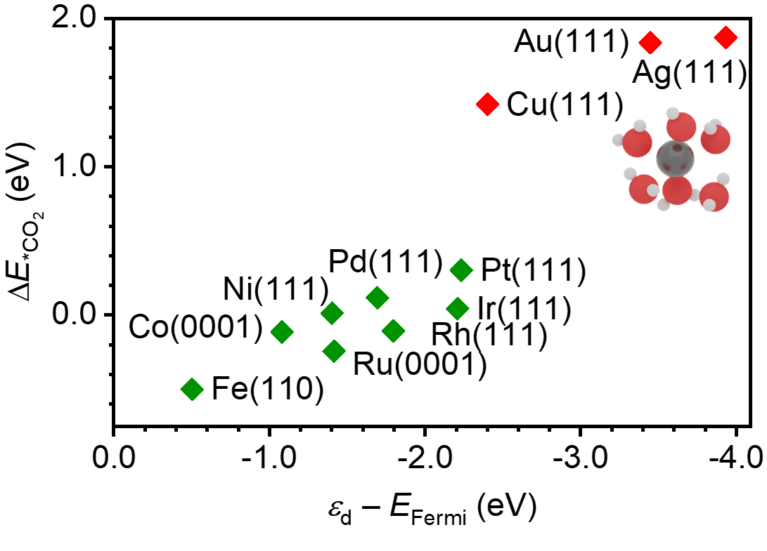
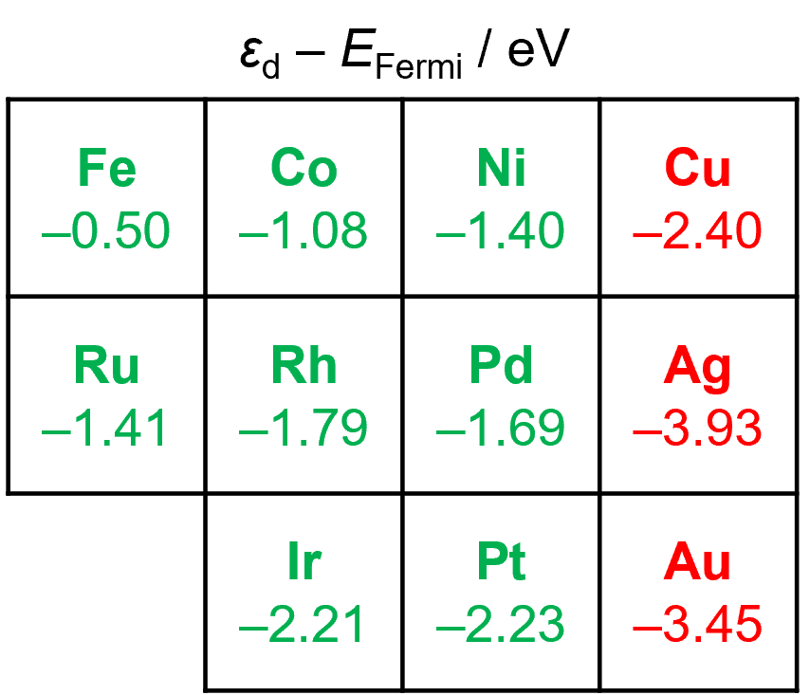
d-band center dependency
ChemCatChem 2025, 17, e00749.
7
Nature 1995, 376, 238–240.

Slide 9
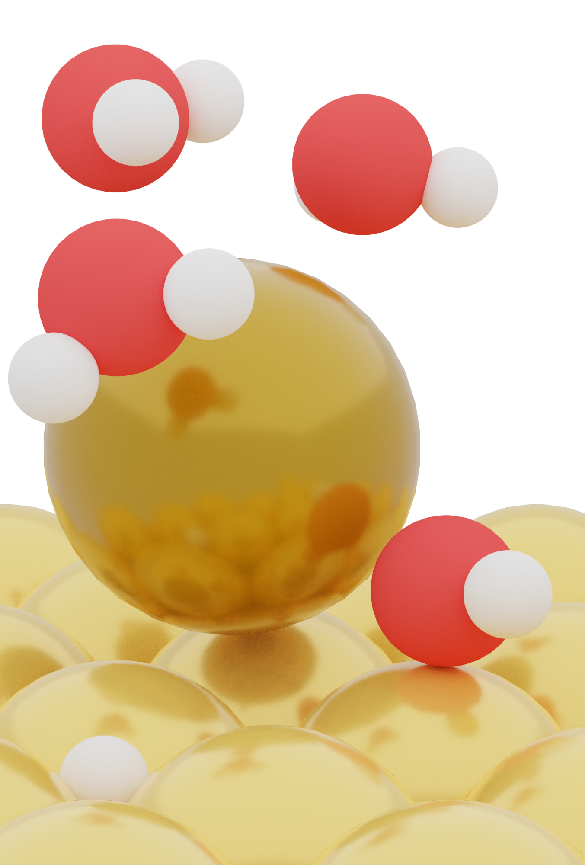
H₂O dissociation
J. Am. Chem. Soc. 2022, 144, 1589–1602.
DFT dataset: 10.19061/iochem-bd-1-213.
8

Slide 10
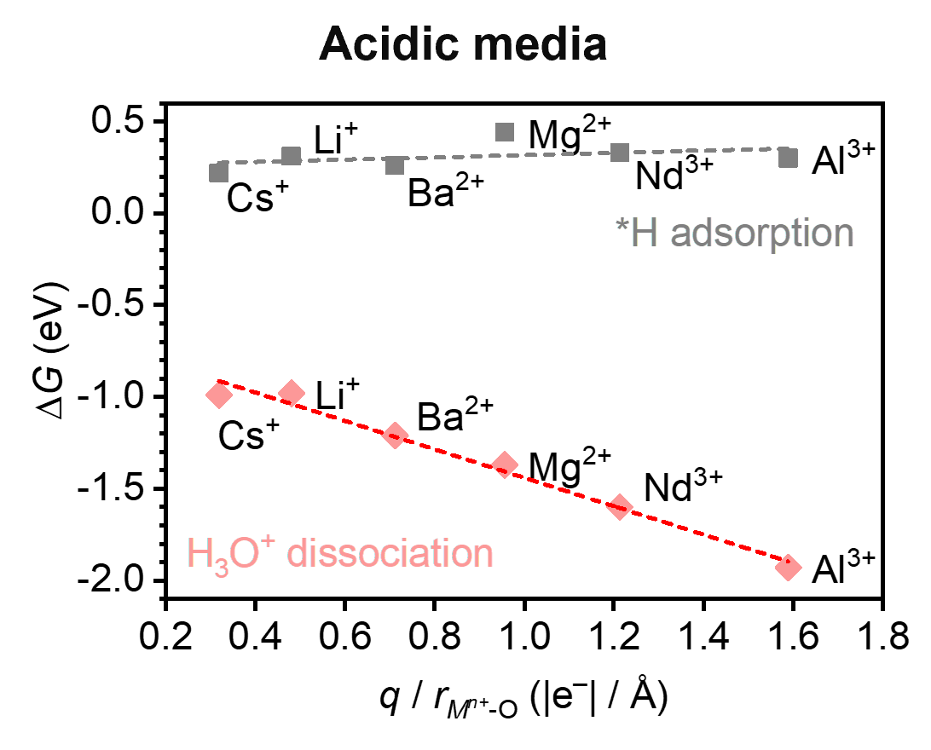
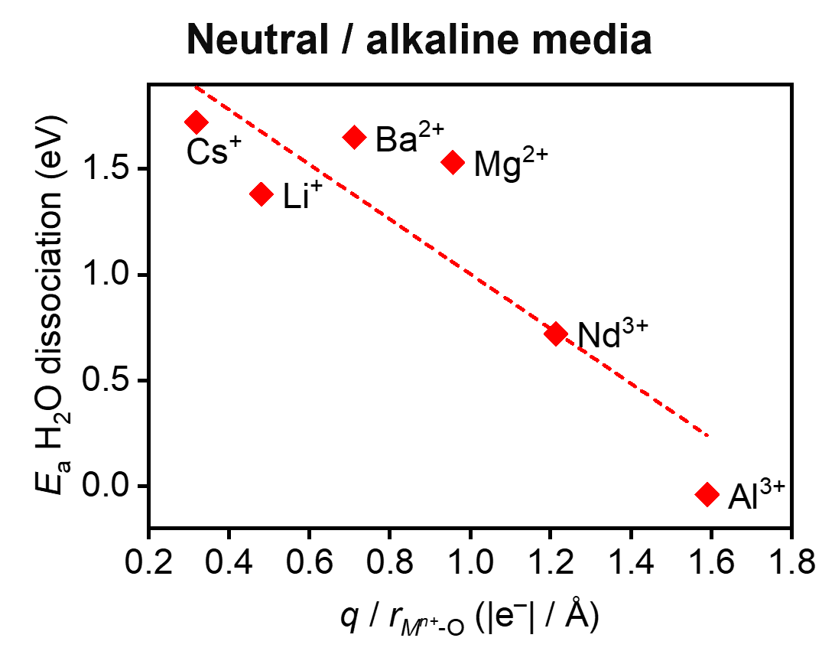
H₂O dissociation vs cation potential
J. Am. Chem. Soc. 2022, 144, 1589–1602.
ChemCatChem 2025, 17, e00749.
9

Slide 11
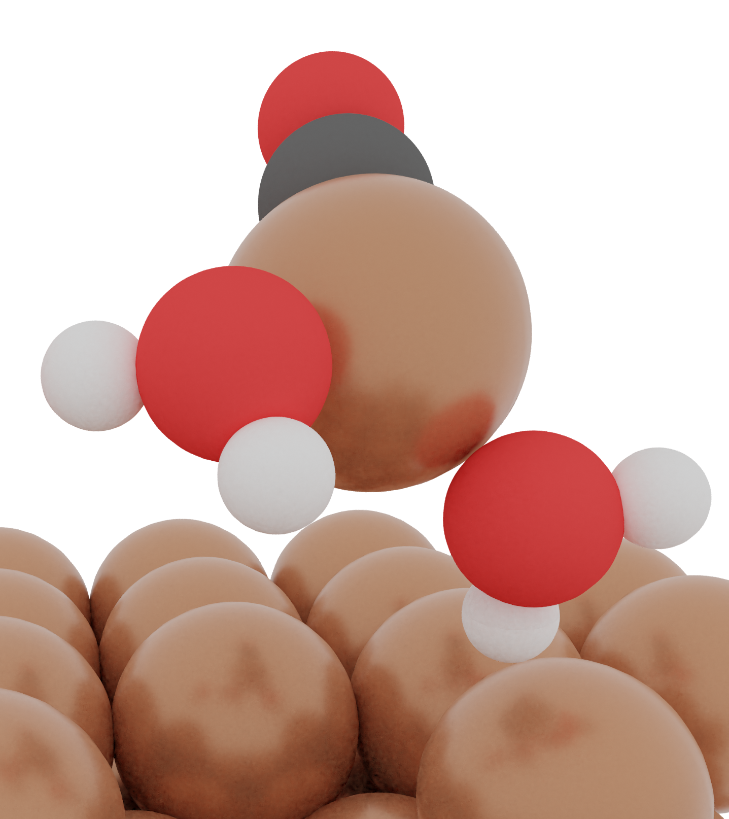
Surface dissolution
Nat. Catal. 2024, 7, 89–97.
DFT dataset: 10.19061/iochem-bd-1-231.
10

Slide 12
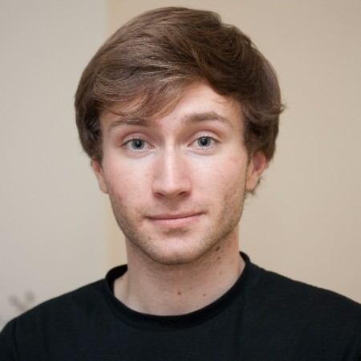
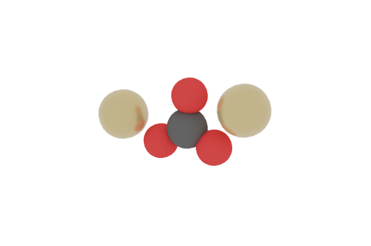
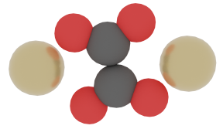
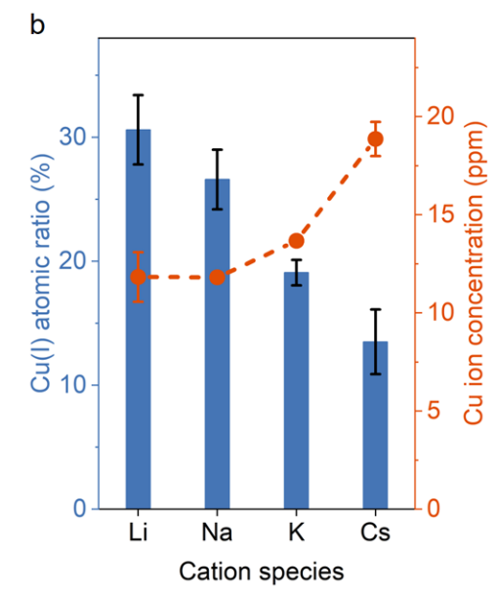

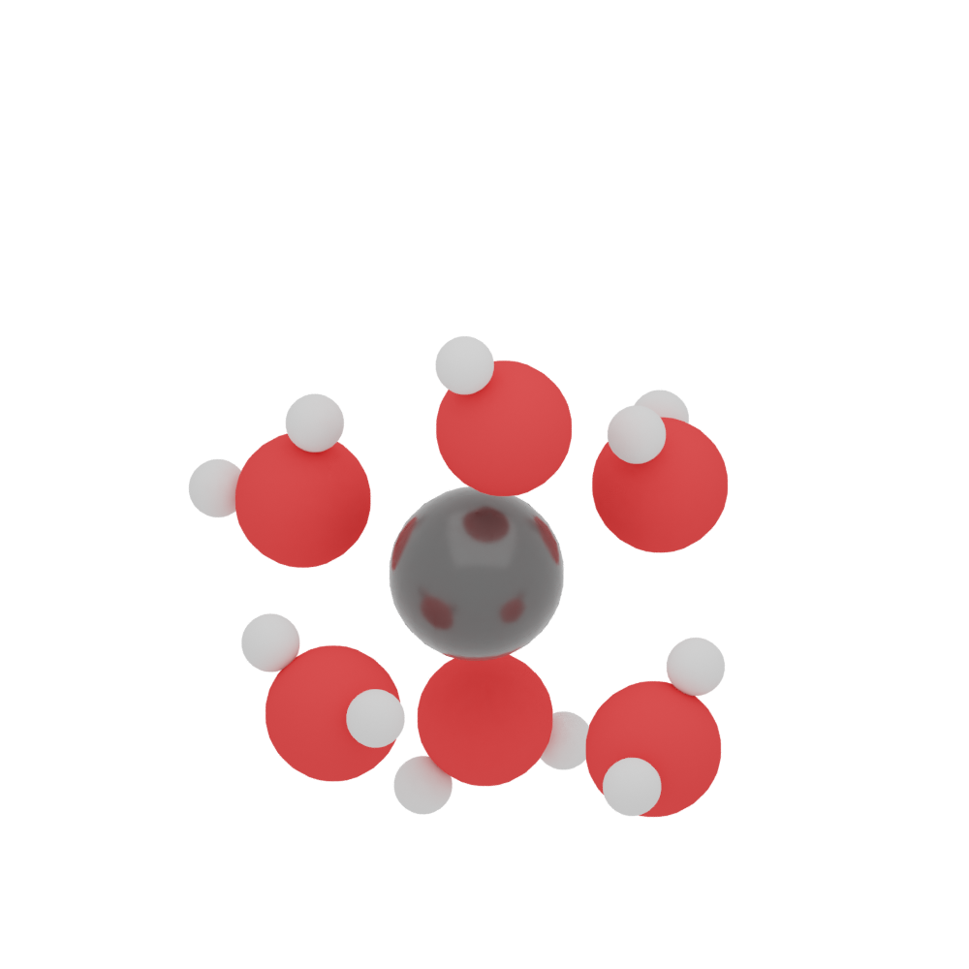

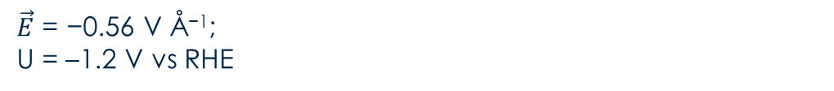
Adsorbates-driven Cu dissolution
[CuCO]⁺ _{3H2O} [Cu₂CO₃] _{5H2O} [Cu₂C₂O₄] _{4H2O}
Dr. Jan Vavra
$\vec{E}$ = −0.56 V Å⁻¹;
U = –1.2 V vs RHE
Nat. Catal. 2023, 6, 837–846. Nat. Catal. 2024, 7, 89–97.
Nat. Commun. 2024, 15, 5080. J. Am. Chem. Soc. 2024, 146, 23901–23908.
11

Slide 13
Correlation Analysis
 | Catalyst | Oxidic pre-treatment | Gas | Electrolyte | Concentration (M) | Cation | E (V vs RHE)
Evolution | +0.36 | +0.13 | +0.25 | −0.35 | −0.45 | +0.17 | +0.09
Evolution
Absent
Unsure
Reconstruction
Degradation
Catalyst
Single crystal
Poly-Cu
Cu NPs
Gas
Absent
Air
Ar
N₂
CO₂
CO
Electrolyte
Absent
Sulphate
Bicarbonate
Phosphate
Alkaline
Concentration (M)
0.05
…
…
…
10
Dissolution database with 15 articles including 85 separate entries.
ChemCatChem 2025, 17, e00749.
12

Slide 14
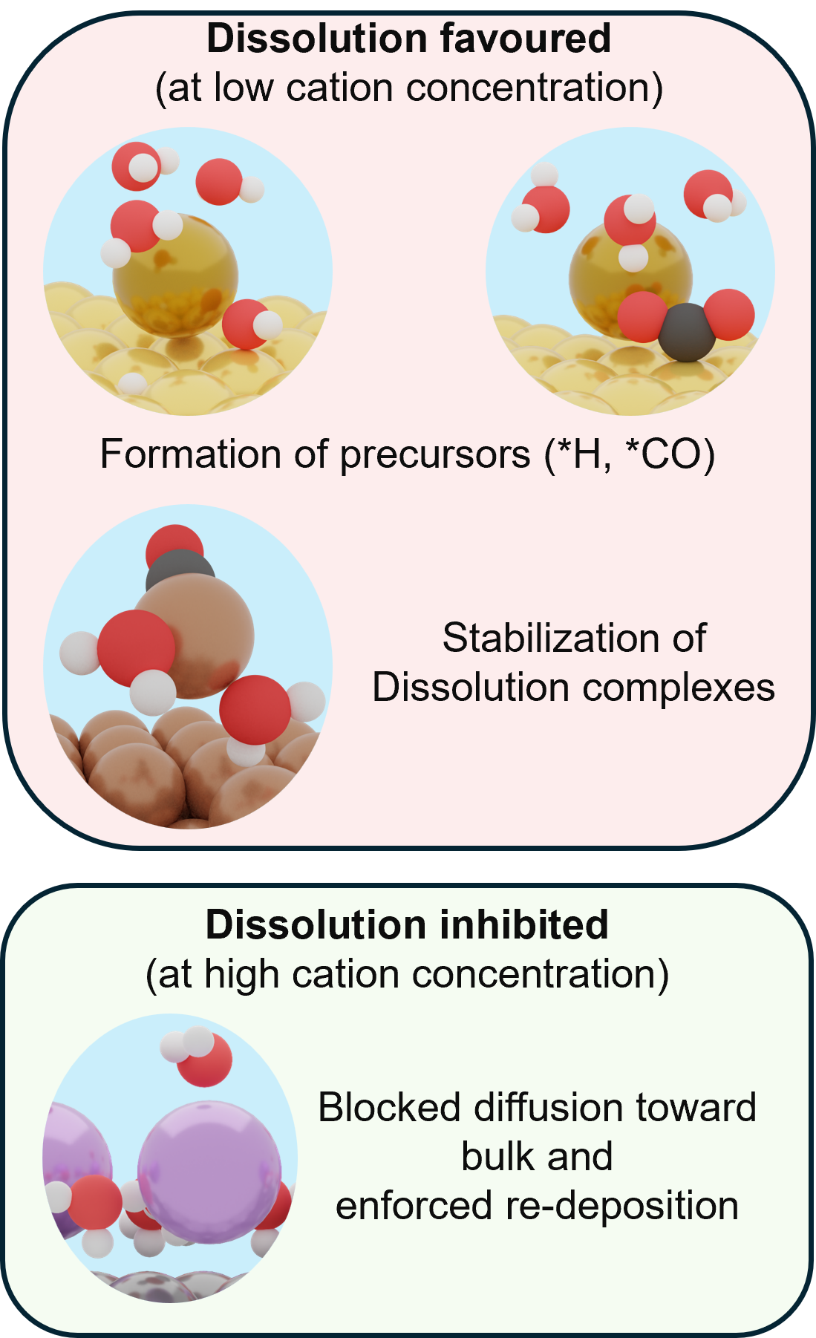
Cation effect
ChemCatChem 2025, 17, e00749.
13

Slide 15
The FAIR problem
of CO₂R
14

Slide 16
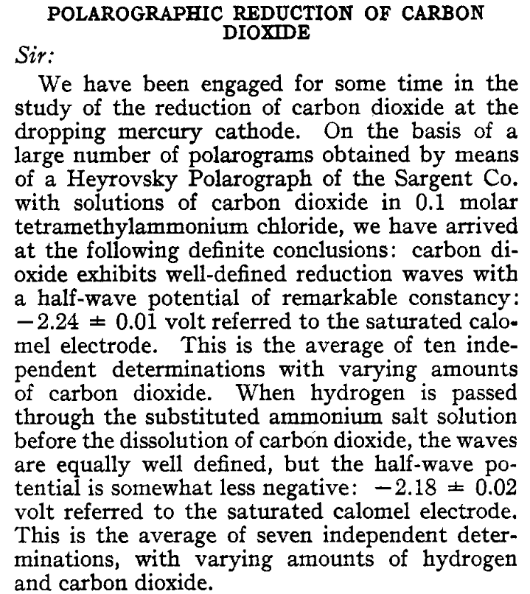
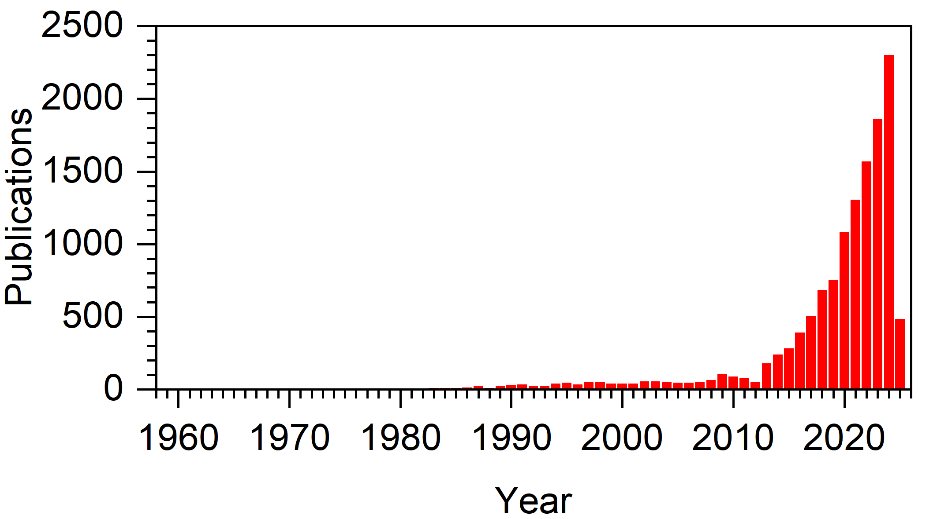
Publications on CO₂R
Van Rysselberghe, P.; Alkire, G. J. J. Am. Chem. Soc. 1944, 66, 1801.
Search on Scopus database using keywords “Electrochemical CO₂ reduction”.
Scopus, https://www.scopus.com, online, accessed on 27/02/2025.
15

Slide 17
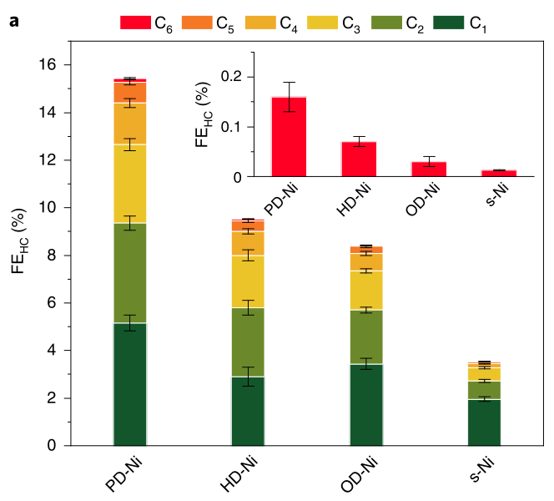

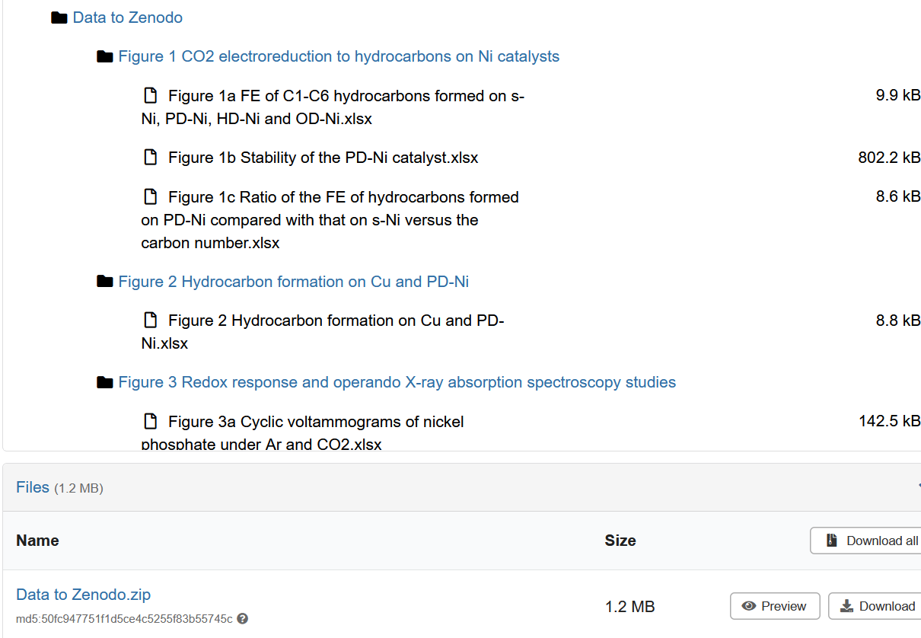
The need for FAIR protocols
Findability / Accessibility / Interoperability / Reusability
Zhou, Y. et al. Nat. Catal. 2022, 5, 545–554. https://doi.org/10.1038/s41929-022-00803-5.
ZENODO repository, https://doi.org/10.5281/zenodo.6331376, online, accessed on 24/09/2025.
16

Slide 18
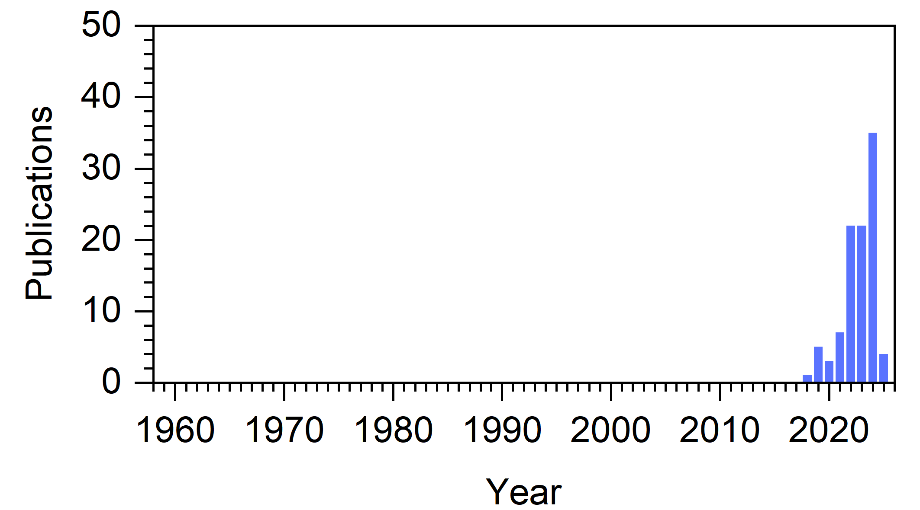
The limit of current repositories
Keywords:
Electrochemical CO₂ reduction
Keywords:
Electrochemical CO₂ reduction, Zenodo
Zenodo Platform, https://zenodo.org, online, accessed on 27/02/2025.
Scopus, https://www.scopus.com, online, accessed on 27/02/2025.
17

Slide 19
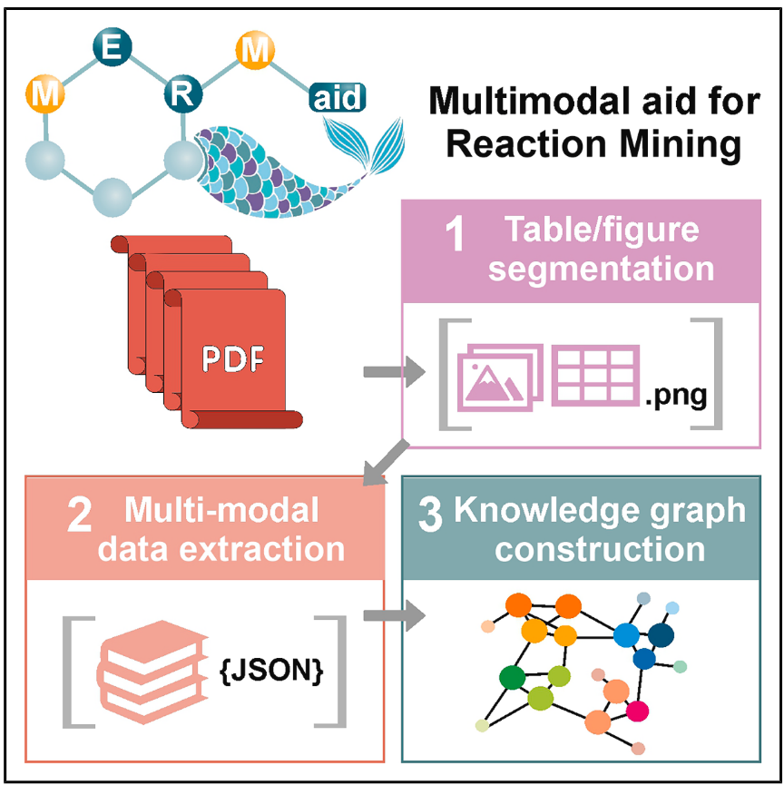
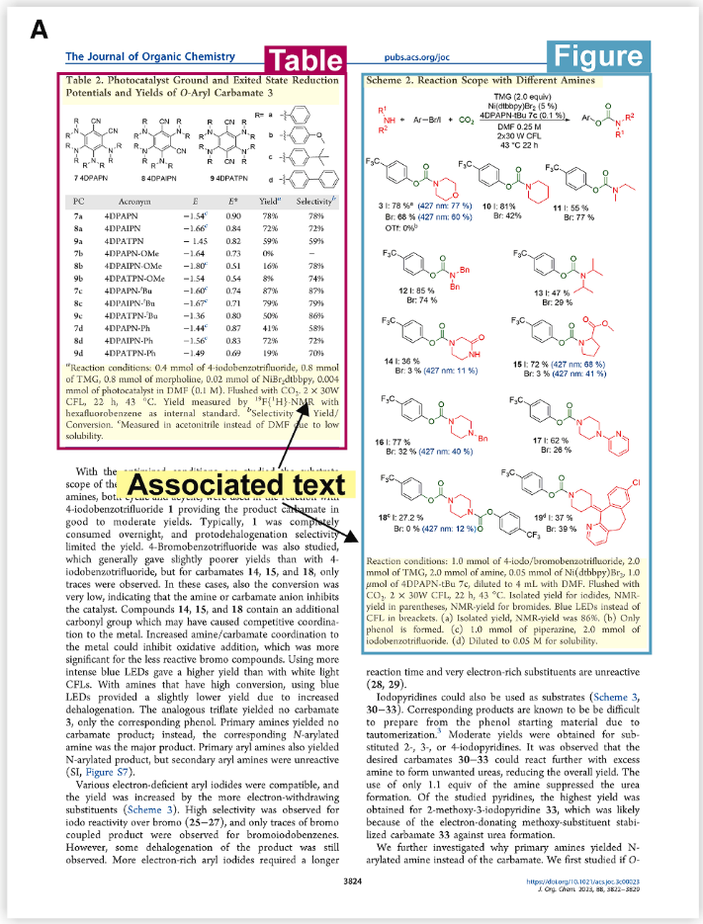
AI-based solution: MERMaid
Leong, S. X.; Pablo-García, S.; Wong, B.; Aspuru-Guzik, A. Matter 2025, 8, 102331. https://doi.org/10.1016/j.matt.2025.102331.
18

Slide 20
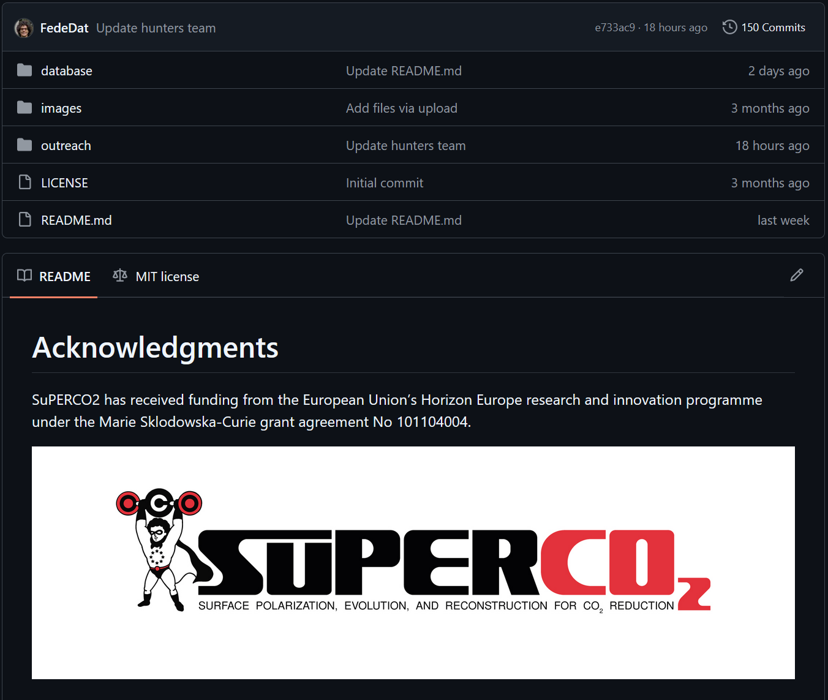
The SuPERCO2 concept
Data Production
Storage
Embargo
Raw Data
Data Analysis
Analysed Data
Lift
embargo
Publication
SuPERCO2, https://github.com/FedeDat/SuPERCO2, online, accessed on 24/09/2025.
19

Slide 21
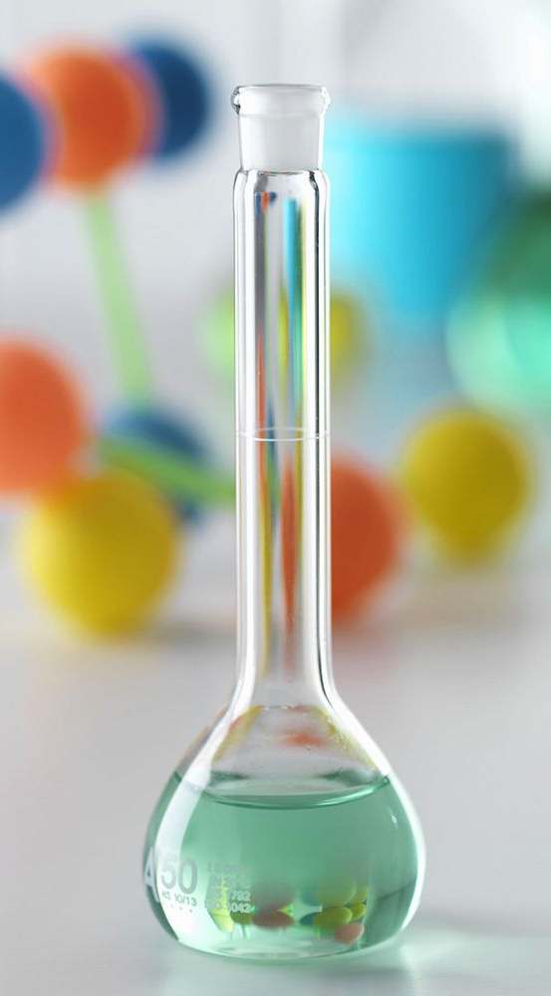
Synthesis
Repository: github.com/FedeDat/SuPERCO2
item: database/data/CuO/synthesis
20

Slide 22
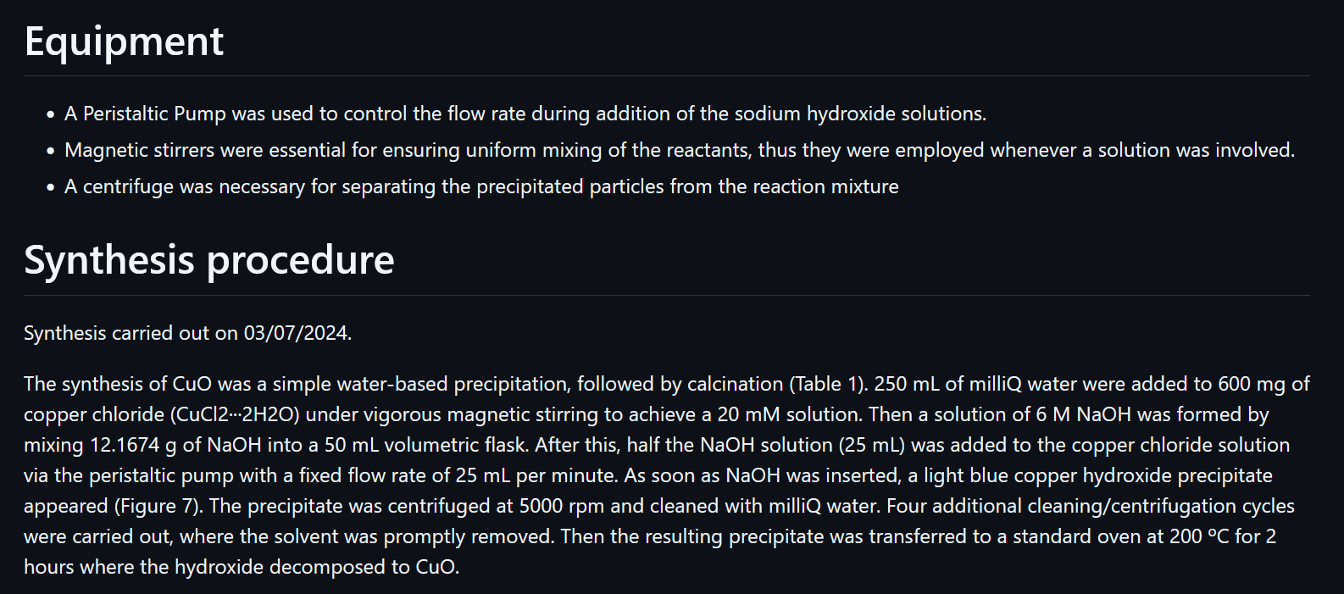
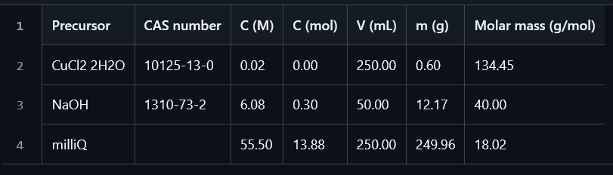
Internal logbook
Precursors
Protocol
https://github.com/FedeDat/SuPERCO2/tree/main/database/data/CuO/synthesis
21

Slide 23
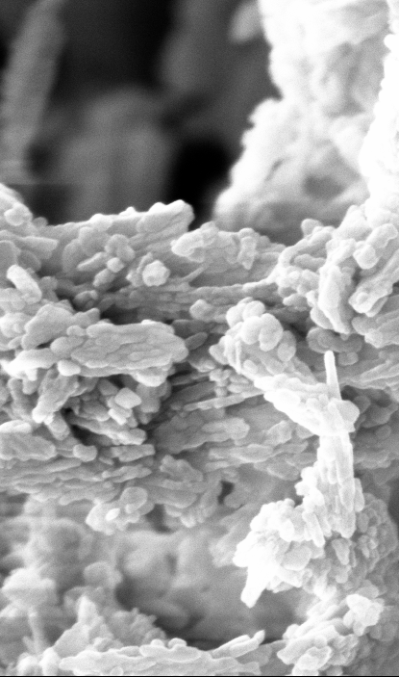
Characterization
Repository: github.com/FedeDat/SuPERCO2
item: database/data/CuO/characterization
22

Slide 24
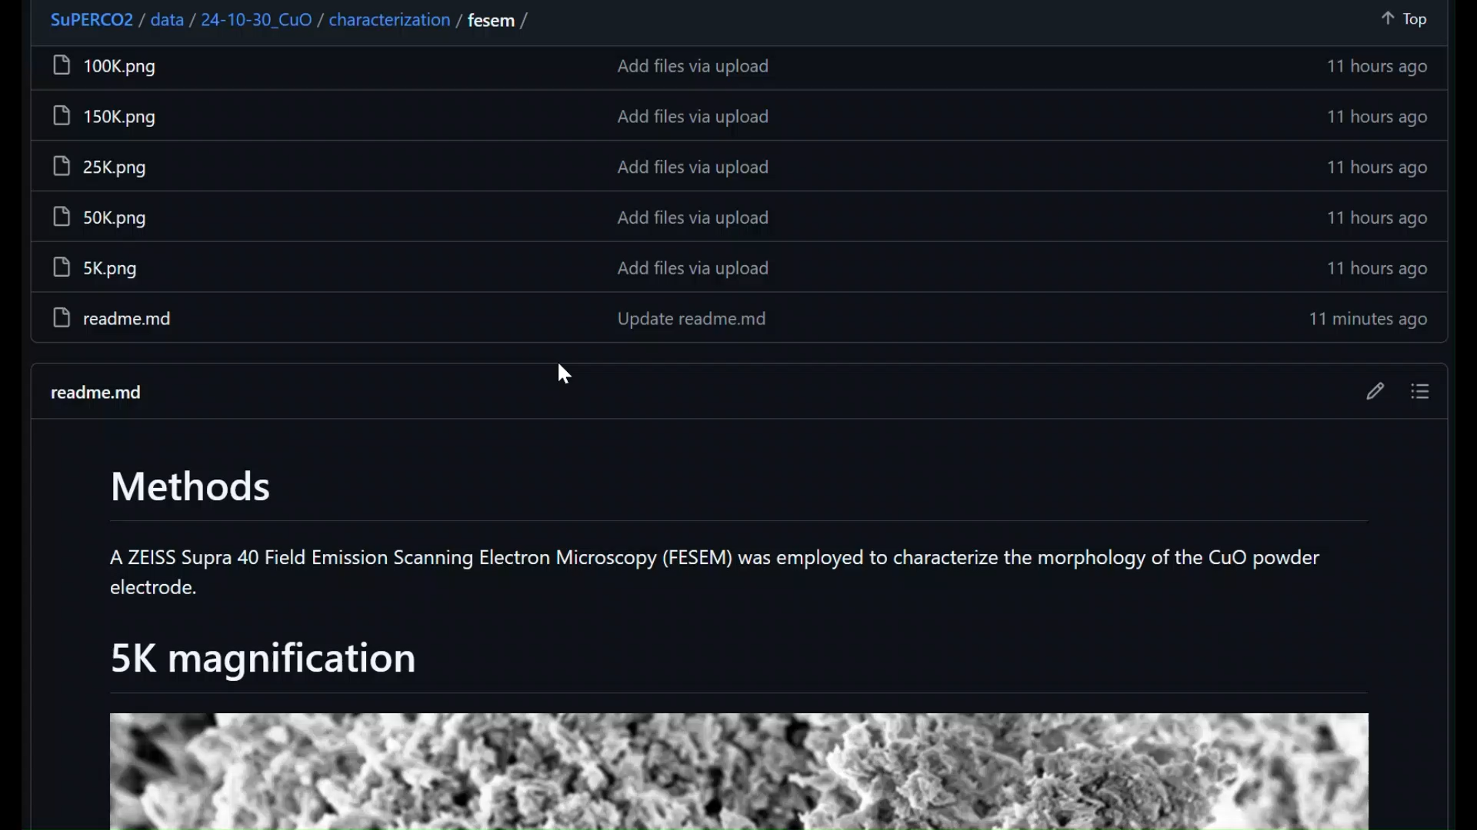
Scanning Electron Microscopy
Post-processing
Data analysis & Visualization
https://github.com/FedeDat/SuPERCO2/tree/main/database/data/CuO/characterization/fesem
23

Slide 25
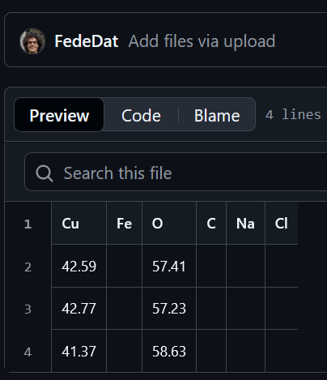
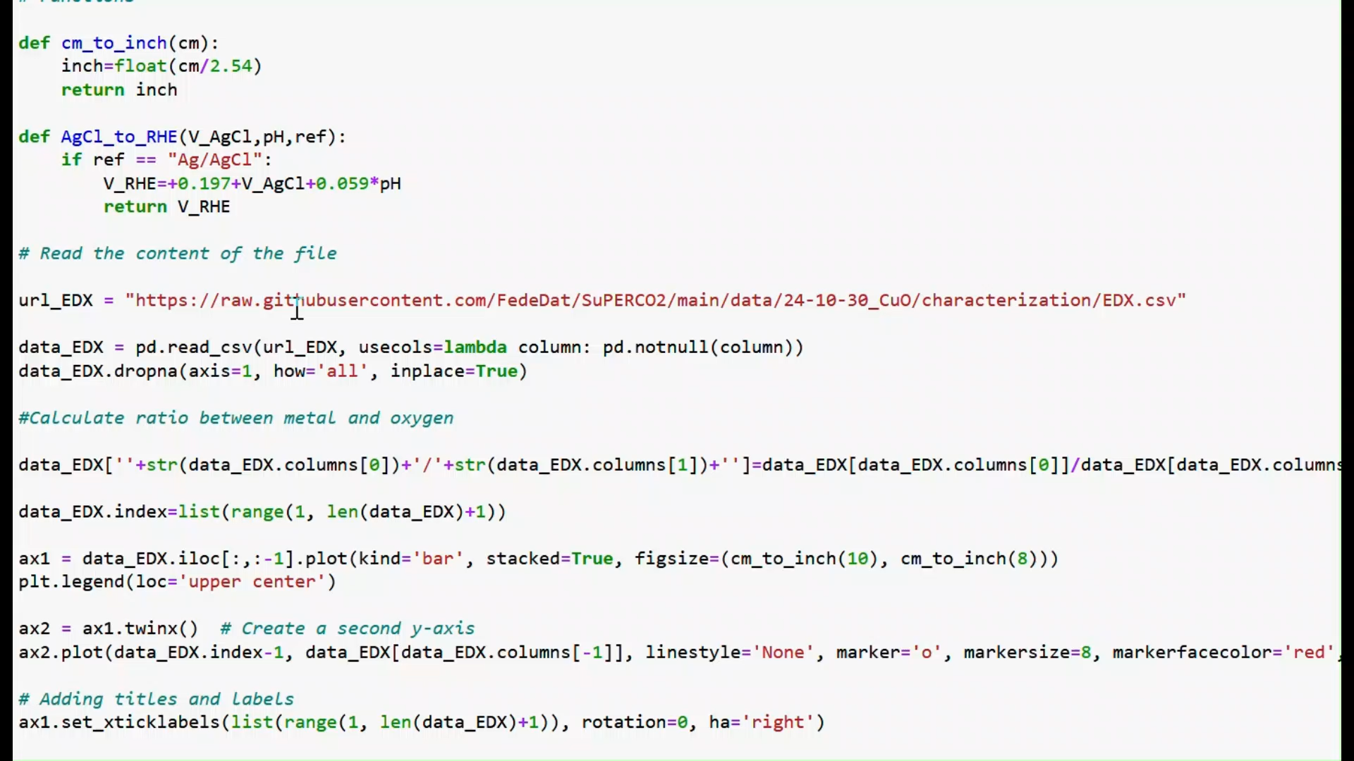
Energy Dispersive X-ray
Post-processing
Data analysis & Visualization
https://github.com/FedeDat/SuPERCO2/tree/main/database/data/CuO/characterization
24

Slide 26
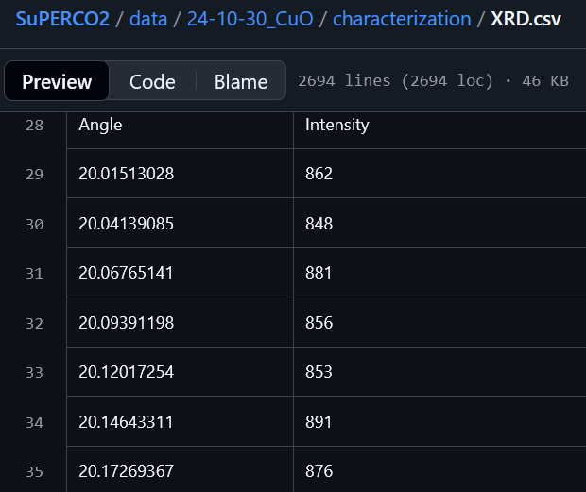
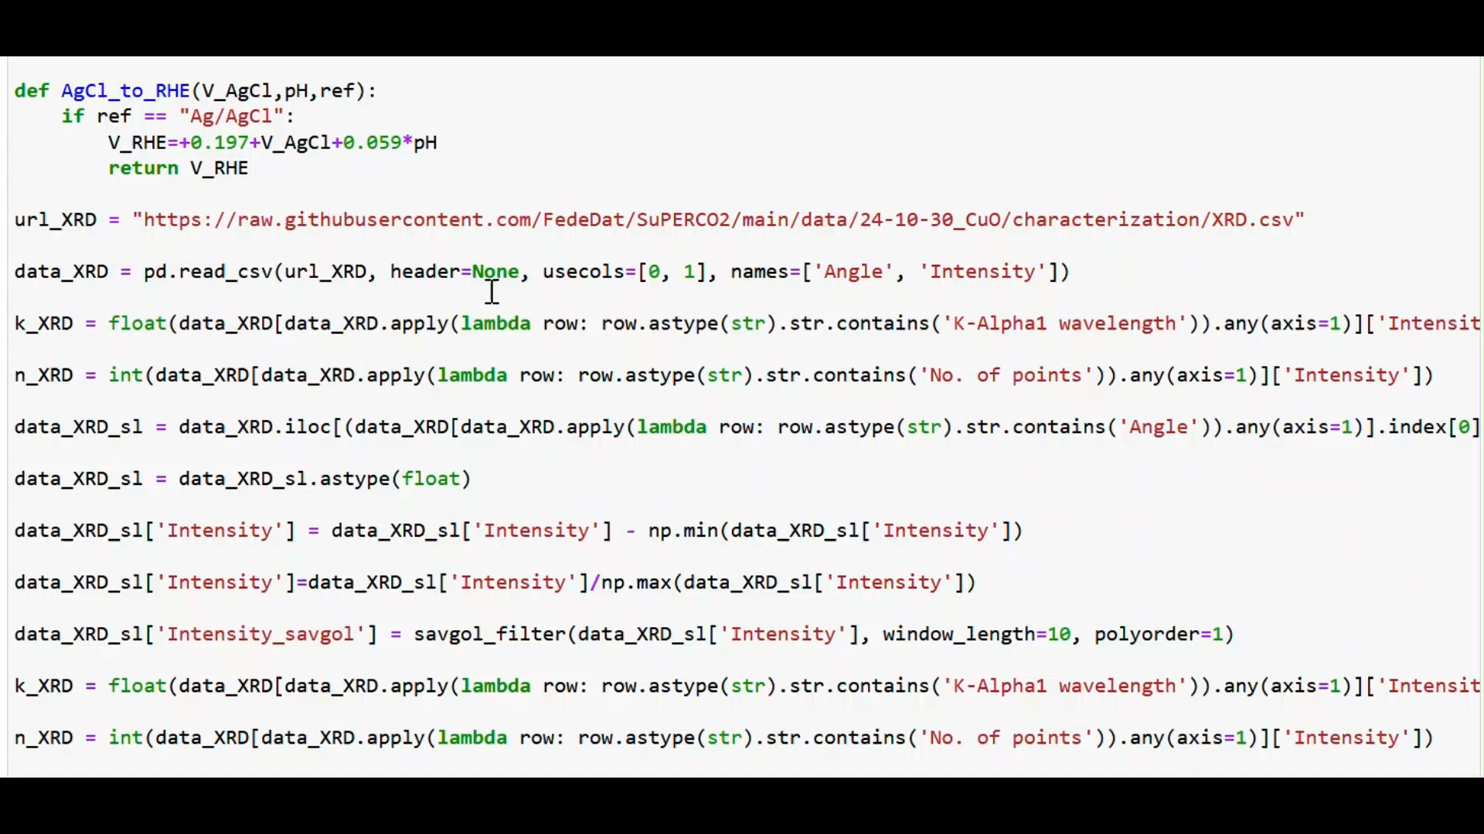
X-ray Diffraction
Post-processing
Data analysis & Visualization
https://github.com/FedeDat/SuPERCO2/tree/main/database/data/CuO/characterization
25

Slide 27
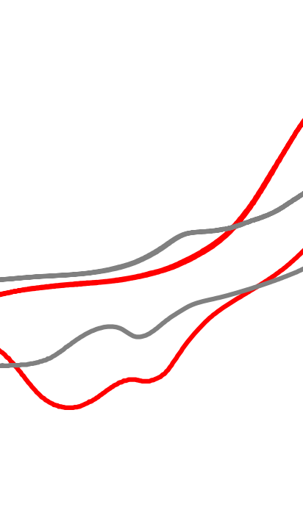
Electrochemical
testing
Repository: github.com/FedeDat/SuPERCO2
item: database/data/CuO/electrochemistry
26

Slide 28
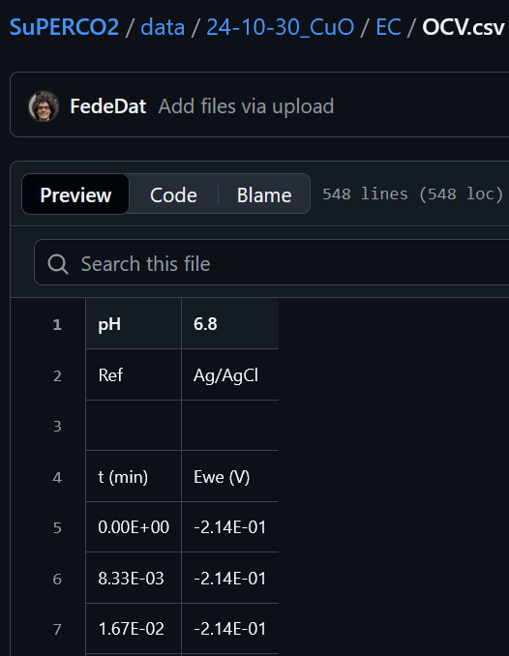
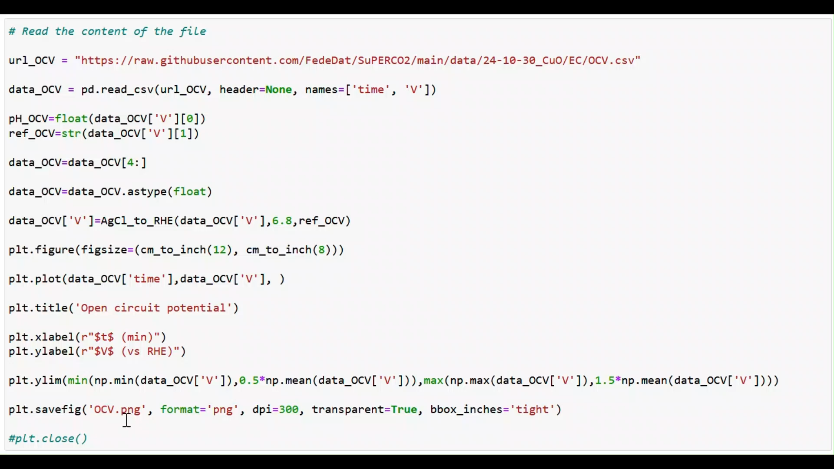
Open Circuit Potential
Post-processing
Data analysis & Visualization
https://github.com/FedeDat/SuPERCO2/tree/main/database/data/CuO/electrochemistry
27

Slide 29
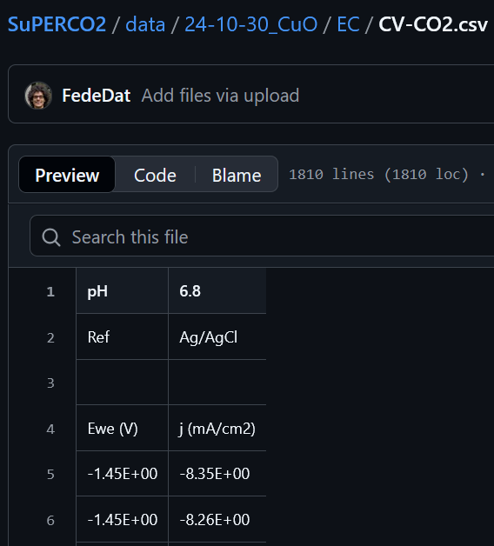

Cyclic voltammetry
Post-processing
Data analysis & Visualization
https://github.com/FedeDat/SuPERCO2/tree/main/database/data/CuO/electrochemistry
28

Slide 30


Chronoamperometry
Post-processing (CA)
Post-processing (GC)
https://github.com/FedeDat/SuPERCO2/tree/main/database/data/CuO/electrochemistry
29

Slide 31



Chronopotentiometry
Post-processing (CP)
Post-processing (GC, HPLC)
https://github.com/FedeDat/SuPERCO2/tree/main/database/data/CuO/electrochemistry
30

Slide 32

Activity & Selectivity (for CA)
Data analysis & Visualization
https://github.com/FedeDat/SuPERCO2/tree/main/database/data/CuO/electrochemistry
31

Slide 33

(Good) practices for outreach
Repository: github.com/FedeDat/SuPERCO2/outreach
Talks, Education games, Videos available
32

Slide 34


Always choose the target & adapt
https://fededat.github.io/
https://github.com/FedeDat/SuPERCO2/tree/main/outreach
33

Slide 35


Use nice visuals and videos
Dr. Edvin
Fako
Tutorials for making nice videos via Blender by Dr. Edvin Fako available for free at https://youtube.com/@efssh?si=vlNTRzeIATBLOroh.
34

Slide 36





Engage your adience (exp 1)
Giulia
Franziska
Paulina
Kun
35

Slide 37




Engage your adience (exp 2)
Lamine Yamal,
Footballer
Anne L’Huillier,
Physics Nobel 2023
Margot Robbie,
Actress
Susumu Kitagawa,
Chemistry Nobel 2025
36

Slide 38


Try interactive, educational games
CO₂ hunters: tutorial available at https://www.youtube.com/watch?v=Be5ySztkNfo; education material at https://github.com/FedeDat/SuPERCO2/tree/main/outreach/games/CO2-hunters.
37

Slide 39

Outlook
38

Slide 40
DFT modeling
CO₂ needs cations for deep ε_{d} metals
∆G(CO₂) ∝ potential (or N(M⁺-CO₂) )
E_{a}(H₂O-diss)∝ 1/cation acidity (potential)
Cation electric potential as descriptor
Cations may interfer with Cu dissolution
39

Slide 41

SuPERCO2 database
The FAIR CO₂R problem
The SuPERCO2 concept
Open data is limited in CO₂R
Early data sharing
Zenodo limits interoperability
Characterization: EDX XRD
AI mining on published data
EC: OCV CV CA/CP
Next steps
Provide tutorial & Wiki online
Add further modules
Optimize for collaborative use vs group-specific
40

Slide 42
Scientific Outreach
Hints
Material
Choose target (& language)
Website: https://fededat.github.io/
Adapt talk to the audience
Database:
https://github.com/FedeDat/SuPERCO2
Use nice visuals and videos
Reduce text (less mistakes!)
Engage audience with Q&A
Talks: outreach/talks
Videos: outreach/videos
Games: outreach/games
Use educational games
41

Slide 43

Acknowledgements (DFT)
Financial support
Density functional theory
Dr. Rodrigo Garcia Muelas,
Prof. Núria López (ICIQ)
Acqueous electrolytes
Dr. Mariana Monteiro, Dr. Chunmiao Yeo, Prof. Marc Koper (Leiden University)
Cu dissolution
Dr. Jan Vavra,
Prof. Raffaella Buonsanti (EPFL)
ELCoREL has received funding from the European Union’s Horizon 2020 research and innovation programme under the Marie Sklodowska-Curie grant agreement No 722614.

Slide 44



Acknowledgements (SuPERCO2)
Inspiration
Financial support
M.Eng. Moisés Àlvarez
(ICIQ)
Exp collaboration
M.Sc. Ali Zarei
(catalyst synthesis, electrochemical testing)
Prof. Simelys Hernández
(lab Access)
SuPERCO2 has received funding from the European Union’s Horizon Europe research and innovation programme under the Marie Sklodowska-Curie grant agreement No 101104004.
43

Slide 45
Thank you!
Questions or feedbacks?
Here or via email at federico.dattila@polito.it
(until February 2026)

Slide 46
Backup slides
45

Slide 47



A predictable CO₂R descriptor
M⁺
O₁
O₂
C
+q
$$\frac{{+q}^{2}}{r_{ion}}$$
– 0.5 ± 0.5
+ 0.04 ± 0.3 acidity + 0.7 ± 0.3 r_{ion}
R² = 0.64
J. Am. Chem. Soc. 2022, 144, 1589–1602.
46

Slide 48

Hints for modeling
Nat. Catal. 2022, 5, 979–981.
DFT dataset: 10.19061/iochem-bd-1-243.
47

Slide 49

Cation stabilization vs dipole
Nat. Catal. 2021, 4, 654–662.
48

Slide 50

Cation accumulation
Nat. Catal. 2021, 4, 654–662.
J. Am. Chem. Soc. 2022, 144, 1589–1602.
DFT dataset: 10.19061/iochem-bd-1-194.
DFT dataset: 10.19061/iochem-bd-1-213.
49

Slide 51

Accumulation vs r_{ion} (alkali group)
Energy at the bulk electrolyte
Li⁺
Na⁺
$M^{+}+ e^{−}↔M, {U=U}_{0}$
$E_{M^{+}+e^{−}}= E_{M}− |e^{−}| (U−U_{0})$
K⁺
Energy at the OHP (from DFT)
$${{∗ + solv+M → ∗ + solv+M}^{+}+ e^{−}}_{ }$$
Cs⁺
+1.5 ± 0.4 – 1.8 ± 0.4 r_{ion}
R² = 0.92
∆E from bulk to OHP
$∆E=E_{M^{+}+e^{−}}\left(OHP\right)−E_{M^{+}+e^{−}}(bulk)$
Nat. Catal. 2021, 4, 654–662.
J. Am. Chem. Soc. 2017, 139, 11277–11287.
50

Slide 52

Accumulation vs acidity (divalent)
+0.22 ± 0.14 + 0.23 ± 0.03 cation acidity
R² = 0.89
J. Am. Chem. Soc. 2022, 144, 1589–1602.
51

Slide 53

CO-CO dimerization
ChemCatChem 2025, 17, e00749.
DFT dataset: 10.19061/iochem-bd-1- 379.
52

Slide 54

CO dimerization vs cation acidity
E_{a}
ChemCatChem 2025, 17, e00749.
53

Slide 55

Formic acid on Pd_{ML}Pt(111)
J. Am. Chem. Soc. 2023, 145, 19601–19610.
DFT dataset: 10.19061/iochem-bd-1-273.
54

Slide 56





Cation effect on HCOOH formation
CO₂R on Pd_{ML}Pt(111)
K⁺
Chunmiao Yeo
K⁺-
free
J. Am. Chem. Soc. 2023, 145, 19601–19610.
J. Am. Chem. Soc. 2015, 137, 4701–4708.
55

Slide 57


Generalization to other metals
K⁺-free
Chunmiao Yeo
K⁺ at 9 Å
K⁺ at 4 Å
CO₂R on Pd_{ML}Pt(111)
U = –0.4 V vs RHE
Pd_{ML}Pt(111)
J. Am. Chem. Soc. 2023, 145, 19601–19610.
56

Slide 58

Tuning of
CO/H₂ ratio in ILs electrolyte
ACS Catal. 2024, 14, 16166–16174.
DFT dataset: 10.19061/iochem-bd-1-306.
57

Slide 59


Anion tuning of CO/H₂ ratio
Dr. Alessia Fortunati
Results for H-cell. Ag foil as working electrode in 0.3 M IL in acetonitrile.
Ni mesh as counter electrode in 0.1 M KOH.
Commun. Chem. 2023, 6, 84.
58

Slide 60

Anion-induced carbene formation
Commun. Chem. 2023, 6, 84.
59

Slide 61


Inhibitory effects on CO₂R
Surface poisoning
CO₂ capture
Commun. Chem. 2023, 6, 84.
60

Slide 62

Thermodynamic descriptors
ACS Catal. 2024, 14, 16166–16174.
61

Slide 63
Surface dissolution
Nat. Catal. 2024, 7, 89–97.
DFT dataset: 10.19061/iochem-bd-1-231.
62

Slide 64
Literature review
Dissolution database with
15 articles
85 separate entries
Entries classified based on
Catalyst
Oxidic pre-treatment
Gas
Type of Electrolyte
Electrolyte Concentration (M)
Type of Cation
E (V vs RHE)
Evolution
Kim, Y.-G. et al. Langmuir 2014, 30, 15053–15056.
Kim, Y.-G. et al. J. Electroanal. 2016, 780, 290–295.
Huang, J. et al. Nat Commun 2018, 9, 3117.
Kim, Y.-G. et al. Electrocatalysis 2018, 9, 526–530.
Speck, F. D. et al. Electrochem. Commun. 2020, 115, 106739.
Vavra, J. et al. Angew. Chem. Int. Ed. 2021, 60, 1347–1354.
Raaijman, S. J. et al. ACS Appl. Mater. Interfaces 2021, 13, 41, 48730–48744
Liu, S. et al. Nat. Commun. 2024, 15, 5080.
Mom, R. V. et al.; ACS Appl. Mater. Interfaces 2023, 2023, 15, 30052−30059.
Li, Z. et al. J. Am. Chem. Soc. 2024, 146, 23901–23908.
Rollier, F. A. et al. ACS Catal. 2024, 14, 13246–13259.
Jiang, S. et al. ChemSusChem 2022, 15, e202102506.
Yang, Y. et al. Nature 2023, 614, 262–269.
Amirbeigiarab, R. et al. Nat. Catal. 2023, 6, 837–846.
Vavra, J. et al. Nat Catal 2024, 7, 89–97.
ChemCatChem 2025, 17, e00749.
63

Slide 65
Quantification of variables
Catalyst |  | Oxidic pre-treatment |  | Gas |  | Cation |  | Electrolyte |  | Evolution
Single crystal | 0 | No | 0 | Absent | 0 | Absent | 0 | Absent | 0 | Absent | 0
Poly-Cu | 1 | Unsure | 1 | Air | 1 | Li⁺ | 1 | Sulphate | 1 | Unsure | 1
Cu NPs | 2 | Yes | 2 | Ar | 2 | Na⁺ | 2 | Bicarbonate | 2 | Reconstruction | 2
 |  |  |  | N₂ | 3 | K⁺ | 3 | Phosphate | 3 | Degradation | 3
 |  |  |  | CO₂ | 4 | Cs⁺ | 4 | Alkaline | 4
 |  |  |  | CO | 5 | Mg²⁺ | 5
 |  |  |  |  |  | Al³⁺ | 6
ChemCatChem 2025, 17, e00749.
64
Notes:
Phosphate before Bicarbonate
Reconstruction -> Dissolution between EDL
Degradation -> Dissolution to bulk
Under CO2 reduction at high current density, not so much difference between bicarbonate-based and alkaline electrolyte.
1 M KHCO3 vs 1 M KOH
Cu-Sn based catalyst
Cu(OH)2

Slide 66

Precursor and Gas effects
Promotion (catalyst)
Promotion (gas)
$$E\left(N_{coord}\right)=E_{0}−A\sqrt{N_{coord}}+BN_{coord}$$
Metal-Metal bond breaking due to strong adsorbate adsorption
NPs
Single crystals
Phys. Rev. B 1993, 48, 1877–1883.
Nat. Catal. 2024, 7, 89–97.
65

Slide 67

CO₂ reduction to C₃₊ products
Nat. Catal. 2022, 5, 545–554.
DFT dataset: 10.19061/ iochem-bd-1-200.
66

Slide 68


Element-dependent CO₂R
ChemPhysChem 2017, 18, 3266–3273.
67

Slide 69


Beyond Cu for C₂₊ hydrocarbons
Polarization-driven
Linear Scaling Relationships (qLSRs)
–1.2 V vs RHE; Ni loading = 170.2 µg/cm²
CO₂-saturared 0.1 M KHCO₃, A = 1 cm²
Nat. Catal. 2022, 5, 545–554.
68

Slide 70



Regeneration of polarized Ni sites
Operando Ni K-edge EXAFS
DFT simulations
After 35 min at –1.2 V vs RHE
H₂O
H₂
Nat. Catal. 2022, 5, 545–554.
69

